Slide 1

SafeLive
Your Guardian in the Urban Jungle

Slide 2
CONTEXT
As the number of crimes increase, tourists are growing more wary which is affecting the local economy, business investment, and public spending
Crime rate in LA (2018-2022) per 100K residents
Most Common Tourist Concerns
Impact
1
Decreased tourism which leads to impact on local economy including jobs and tax revenue
Safety
Scams
Navigation
2
Impact on business investment due to perception of safety and property crime impact
Health
Transportation
Cultural Etiquette
3
Increased public service spending notably law enforcement cost
Language Barrier
4
Impact on quality of life, social cohesion and community development
5
Direct and indirect impact on GDP
High Concern
Low Concern
Source: CNN, USA Today, LAPD reports, LA mayor’s office report
Covered in SafeLive App

Slide 3

PRODUCT
Introducing our innovative AI-powered live map designed to guide you safely through LA's vibrant neighborhoods.
Our app is dedicated to providing real-time insights, steering you clear of potential danger zones and empowering you with accurate information on neighborhood safety levels.
Tailored to your profile, we offer precise details on the most common types of crime in each area, ensuring proactive and informed travel.
With us, explore LA confidently, knowing you're equipped with the knowledge to navigate safely."

Slide 4





KEY FEATURES
MVP
Roadmap
Predicting risk level of neighborhoods
Anticipates crime risk levels by analyzing user's ethnicity, day of the year, and location
Advanced Prediction using Video Feed and Web News
Anticipating risk through video analysis and NLP-driven news scraping
Risk assessment
Evaluates neighborhood risk levels based on user-provided data
Path risk analysis
Input your starting point and destination; receive the safest route with risk scores.
To be reviewed with team

Slide 5

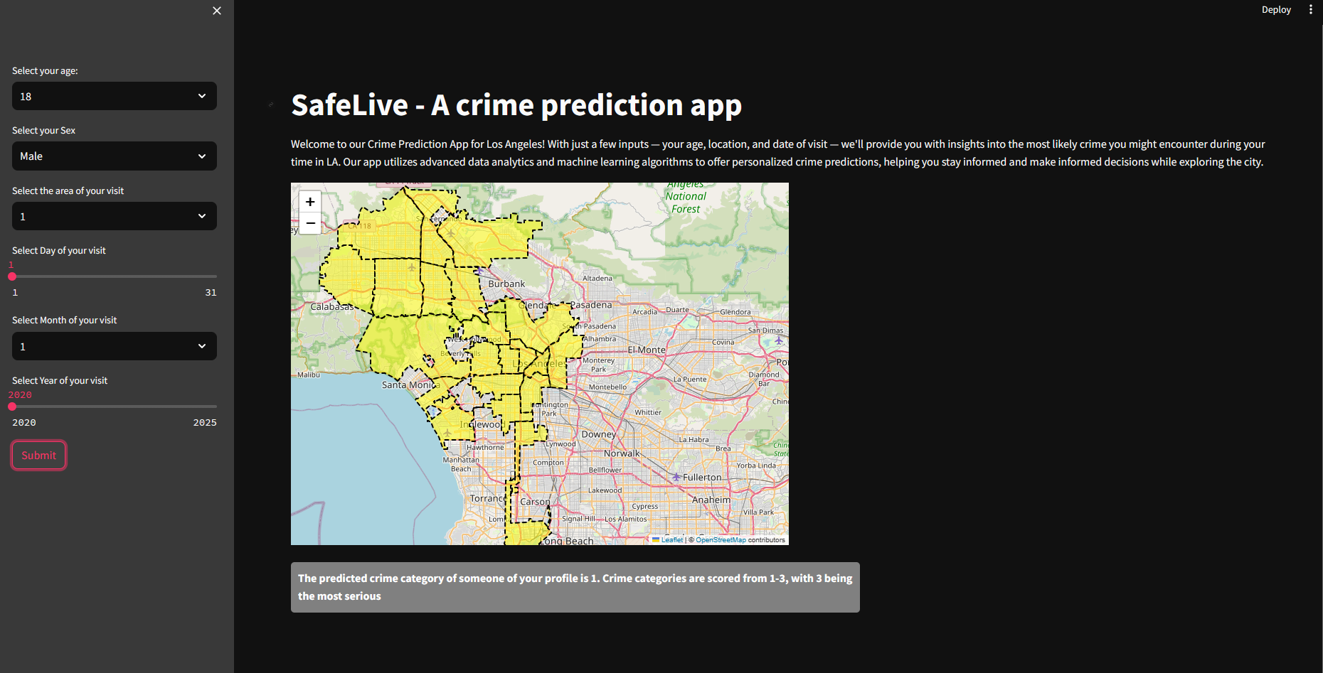
LIVE DEMO
This needs to be updated with latest one

Slide 6

HOW IT WORKS
The Dataset
850,000+ datapoints
The Model
Trained a SVM model on a custom dataset
Of crimes in LA from 2020 to 2023
Labeled by the LAPD
AdamW optimizer
Learning rate = 0.000714
Momentum = 0.9
Weight decay separation
Controlled learning
Speeds convergence
This needs to be updated with our model specifications
Binary classification
Labeled classes crying/not_crying as proof-of-concept detection model
Multiclass classification
Pain level range 0-3 on the Edin Scale- clinically validated tool for pain assessment in newborns
This needs to be updated with our model specifications

Slide 7



ROADMAP
Enhance the model performance : Add video feed data by converting videos to tabular data ; add webscaraped news data by using webscraping techniques
Add Hospital Data
Add geodata on nearby hospitals to help tourists in distress find the nearest one quickly
Model & Data
Route Planning:
Enable users to input their starting point and destination. Utilize the predictive model to generate the safest route considering factors like crime rates, time of day, and user preference
Alerts and Notifications
Implement alerts to notify users of any significant changes in risk levels along their chosen route.
Features
Mobile Application: Develop a user-friendly mobile app for both iOS and Android platforms,
Data Integration: Establish partnerships or APIs with relevant data providers such as law enforcement agencies, local governments, and news outlets to access up-to-date information.
Monetization Strategy: Consider revenue streams such as subscription models, freemium features, or partnerships with local businesses for advertising or sponsored content.
Ecosystem

